Slide 1


Hospitality Revenue Analytics: AtliQ Grands
Presented by:
Radha Prakash Nair

Slide 2


Contents
Introduction Problem Statement Dataset Data Cleaning & Transformation Insights Generation Conclusion

Slide 3


Introduction
AtliQ Grands is a prominent Indian hotel chain with a diverse portfolio of hotels operating in cities such as Delhi, Mumbai, Bangalore, and Hyderabad. With 20 years of industry experience, they offer various hotel types, including luxurious ones like AtliQ Palace and business-focused options like AtliQ Seasons. To address declining revenue and market share, AtliQ Grands is embracing data analytics to inform its decision-making process. This project focuses on analyzing booking data from multiple sources to identify opportunities for revenue growth and improved competitiveness.

Slide 4


Problem Statement
AtliQ Grands, a reputable Indian hotel chain, faces declining revenue and market share. To reverse this trend, they have embarked on a data-driven approach by leveraging data analytics.
The project's objective is to analyze booking data from diverse sources, including their website and third-party platforms, to discover strategies for increasing revenue and enhancing competitiveness.

Slide 5


Dataset
We have 5 csv files
dim_date.csv
date, mmm yy, week no, day_type
dim_hotels.csv
property_id, property_name, category, city
dim_rooms.csv
room_id, room_class
fact_aggregated_bookings.csv
property_id, check_in_date, room_category, successful_bookings, capacity
fact_bookings.csv
booking_id, property_id, booking_date, check_in_date, checkout_date, no_guests, room_category, booking_platform, ratings_given, booking_status, revenue_generated, revenue_realized

Slide 6


Data Cleaning & Transformation
1.Clean Invalid Data
2.Outlier Removal 3.Creating New Columns

Slide 7

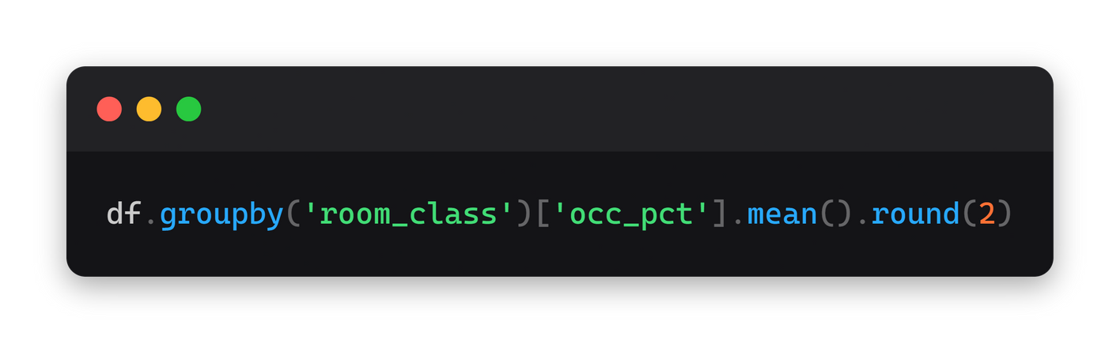
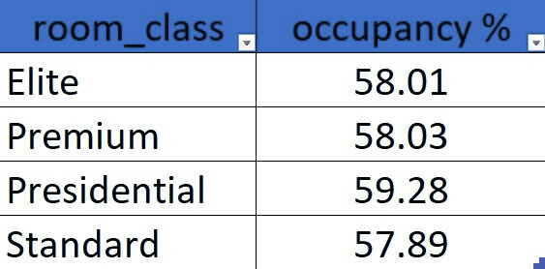

Insights Generation
1. WHAT IS THE AVERAGE OCCUPANCY RATE IN EACH OF THE ROOM CATEGORIES?
Among the room categories, the "Presidential" rooms have the highest average occupancy rate (59.30%), indicating their popularity among guests.

Slide 8

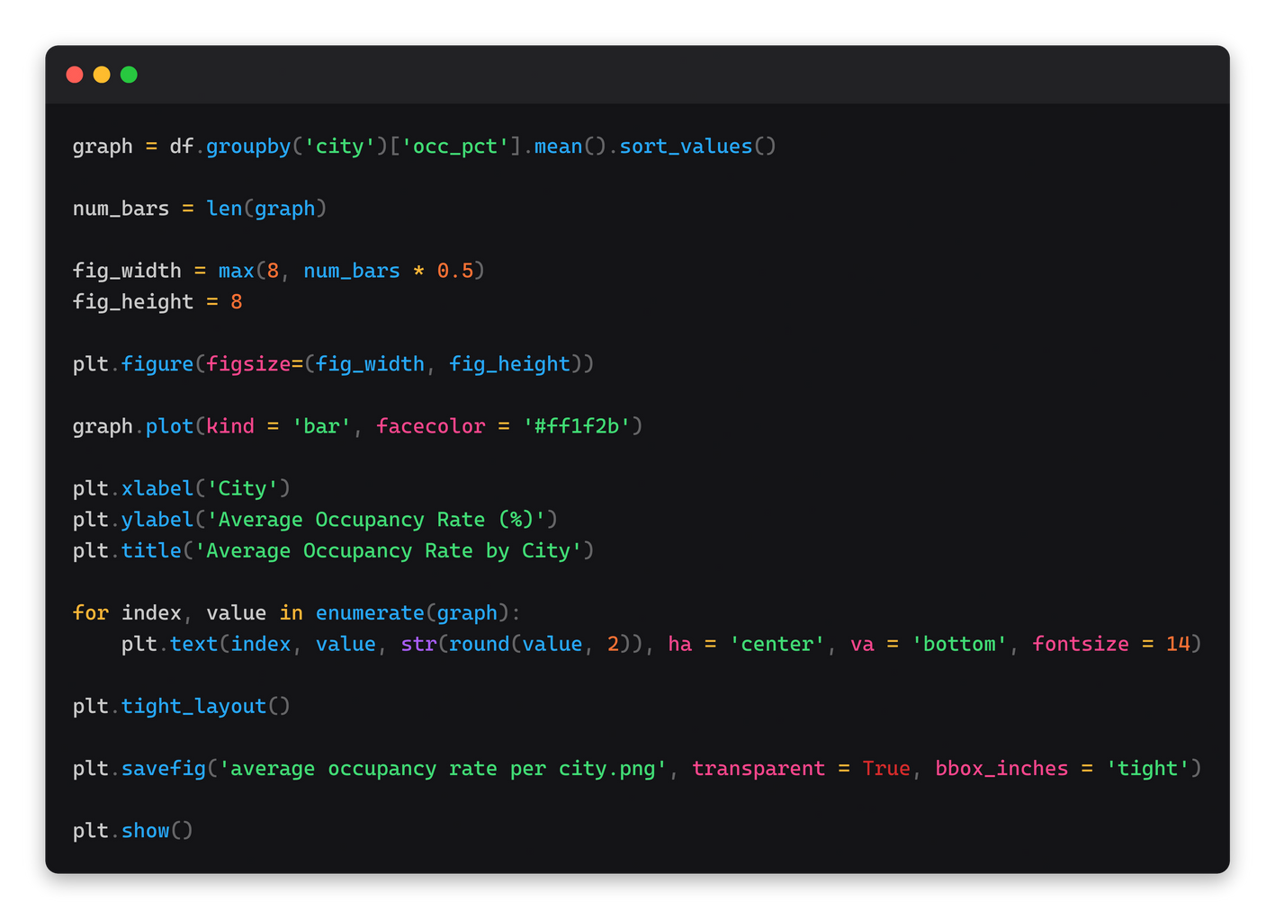
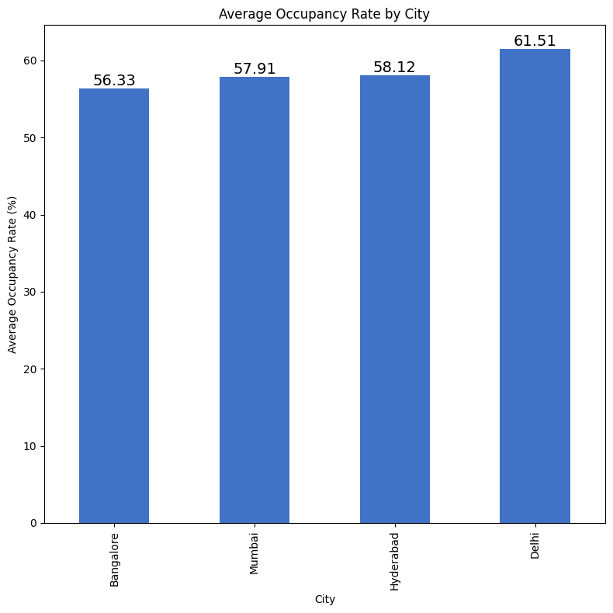

2. WHAT IS THE AVERAGE OCCUPANCY RATE PER CITY
Delhi has the highest average occupancy rate among cities (60.40%), while Bangalore has the lowest (55.29%).

Slide 9

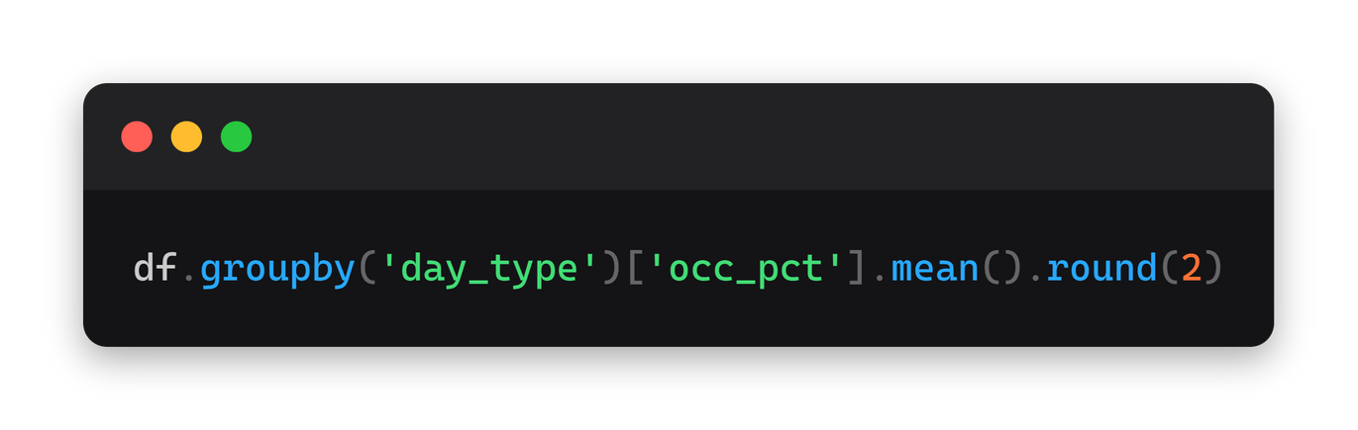

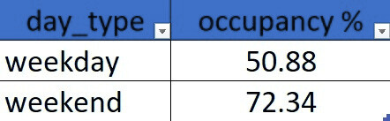
3. WHEN WAS THE OCCUPANCY BETTER? WEEKDAY OR WEEKEND?
Weekends show significantly higher occupancy rates compared to weekdays, indicating a potential opportunity for targeted marketing or pricing adjustments.

Slide 10


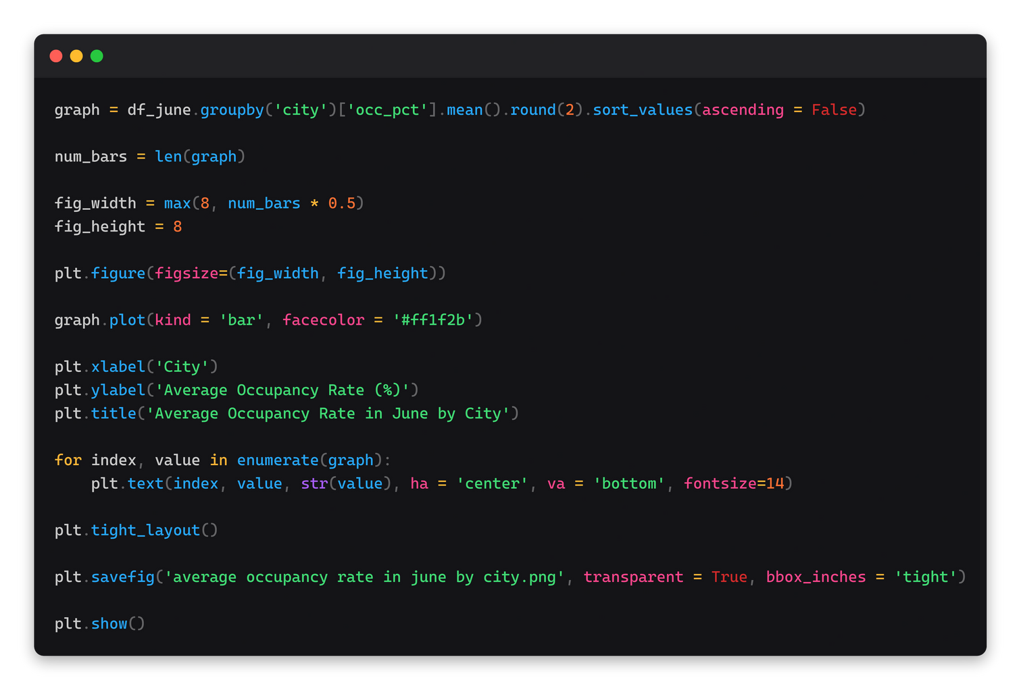
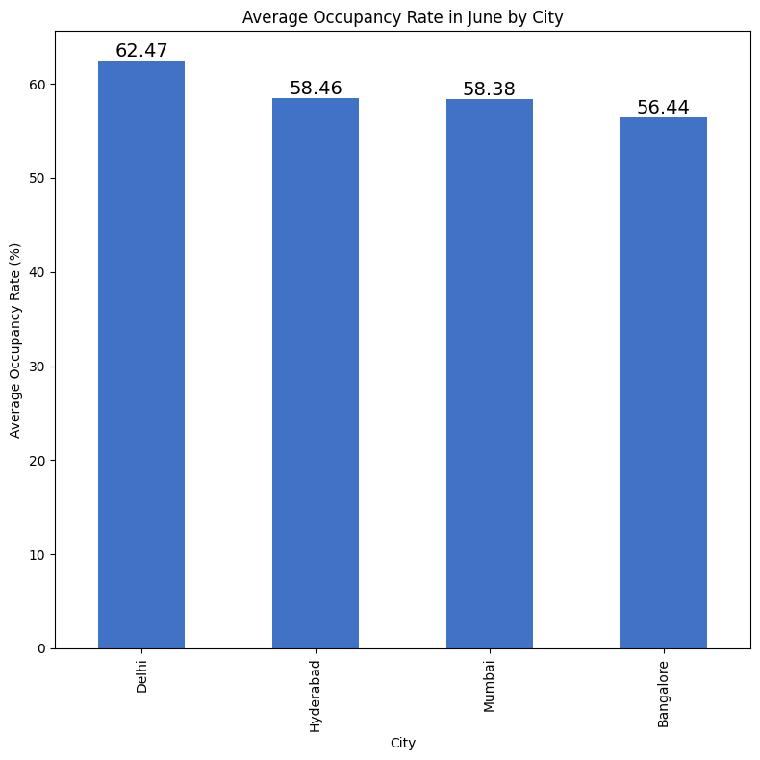
4. IN THE MONTH OF JUNE, WHAT IS THE OCCUPANCY FOR DIFFERENT CITIES
In the month of June, Delhi had the highest occupancy rate (62.47%), followed closely by Hyderabad (58.46%).

Slide 11

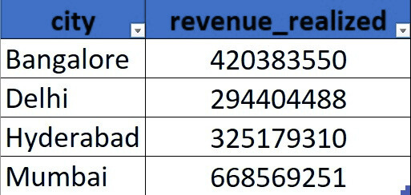
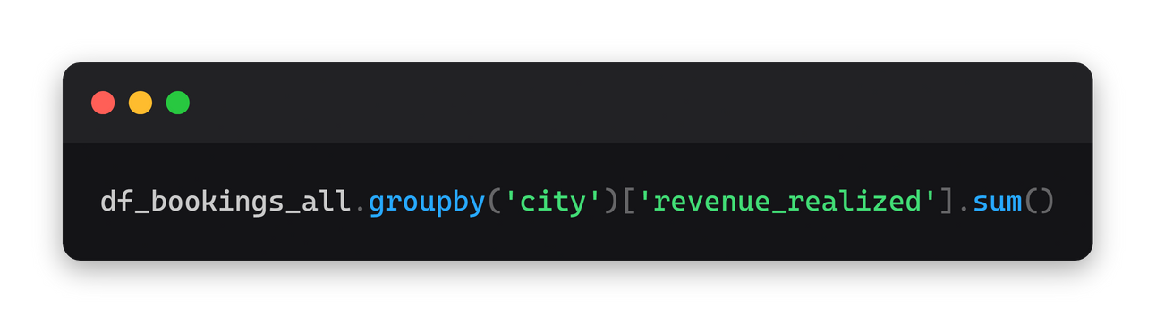

5. WHAT IS THE REVENUE REALIZED PER CITY
Mumbai generates the highest revenue among the cities.

Slide 12

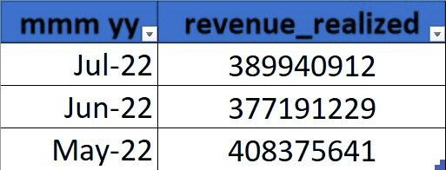
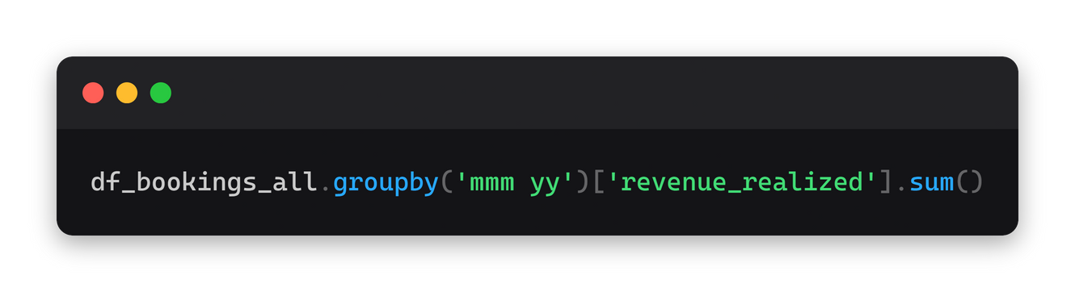

6. WHAT IS THE MONTH BY MONTH REVENUE
The hotel's revenue fluctuates month by month, with July 2022 generating 38,99,40,912 INR and May 2022 generating 40,83,75,641 INR.

Slide 13

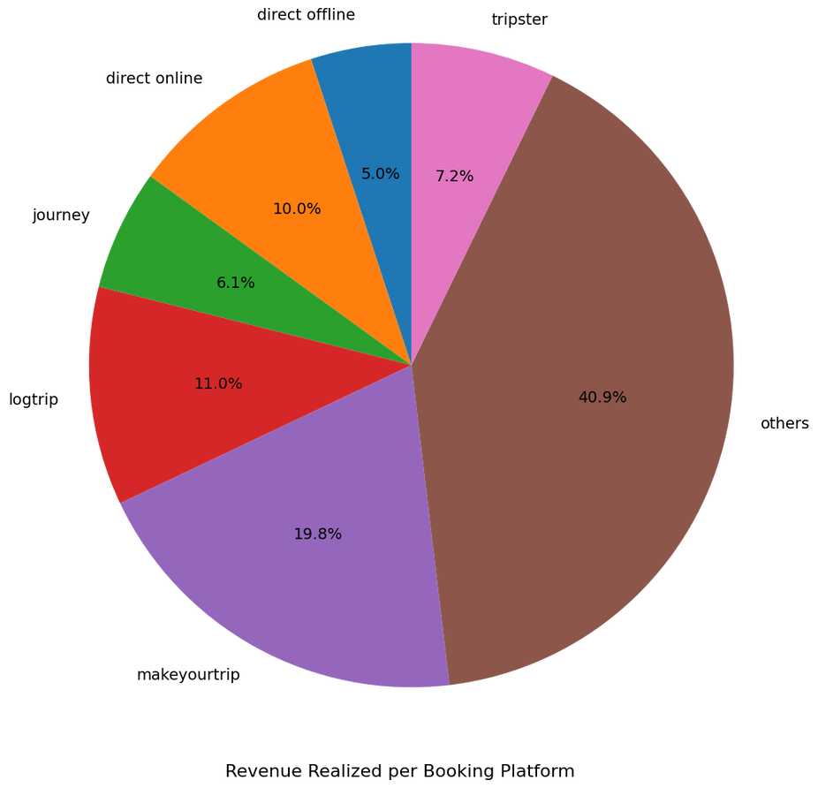
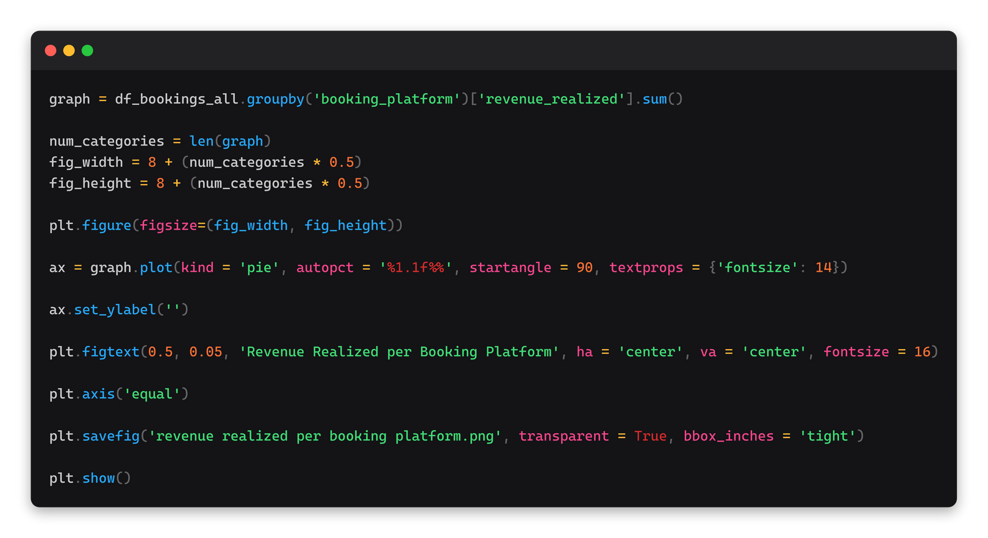
7.PRINT A PIE CHART OF REVENUE REALIZED PER BOOKING PLATFORM
The revenue realized per booking platform varies, with "others" being the highest contributor , followed by "makeyourtrip" .

Slide 14

Conclusion
Implement Weekend-Specific Promotions: Develop and implement weekend specific promotions and packages to attract more guests during weekends. This could include special deals, events, or amenities tailored to weekend travelers.
Invest in Expanding in Delhi: Given the higher occupancy rate in Delhi, consider expanding the hotel chain's presence in the city by opening more properties or enhancing existing ones. This strategic expansion can help further boost revenue and market share.

Slide 15



